Slide 1
Week 7 & 8
DSC 640
Abed Tabbalat

Slide 2
Python

Slide 3

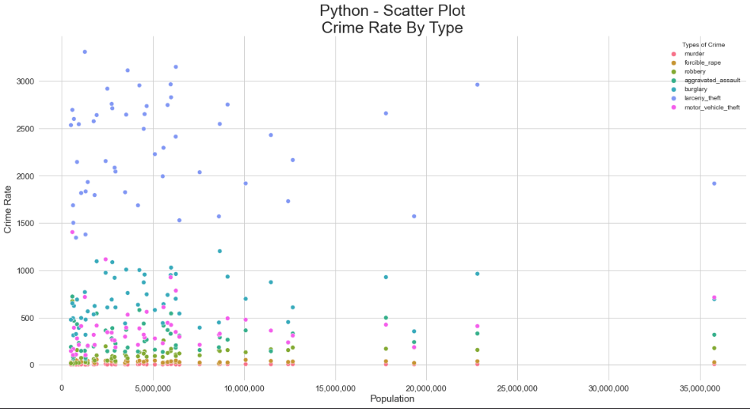
Python – Scatter Plot

Slide 4
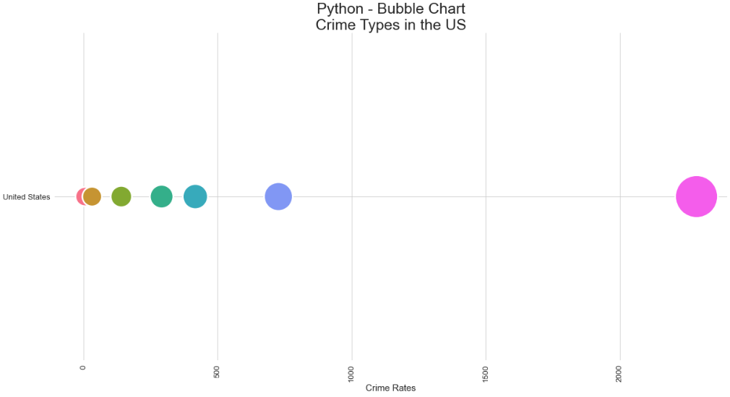
Python – bubble Chart

Slide 5
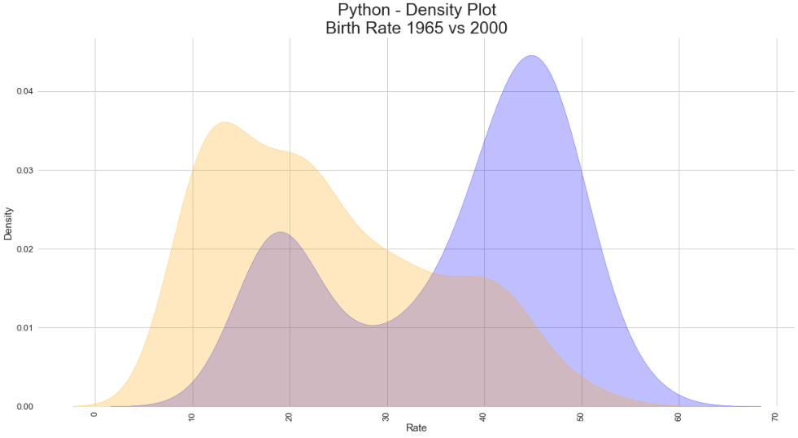
Python – density plot

Slide 6
R

Slide 7
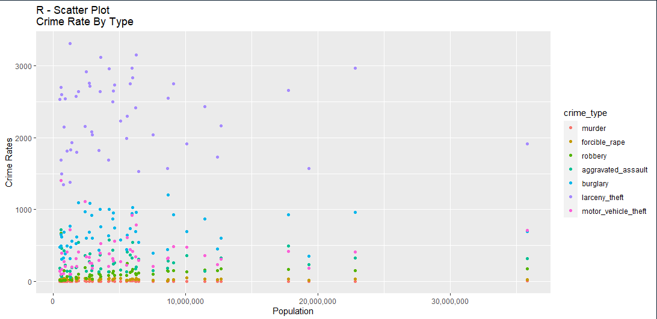
R – scatter plot

Slide 8
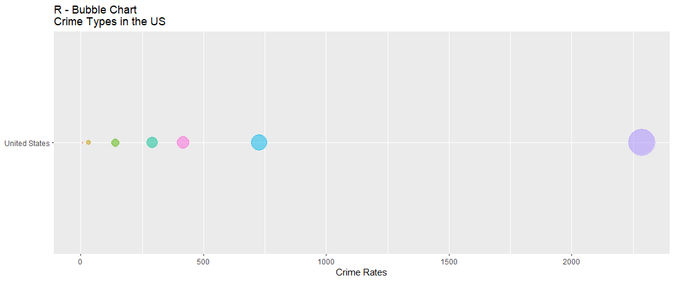
r – bubble Chart

Slide 9
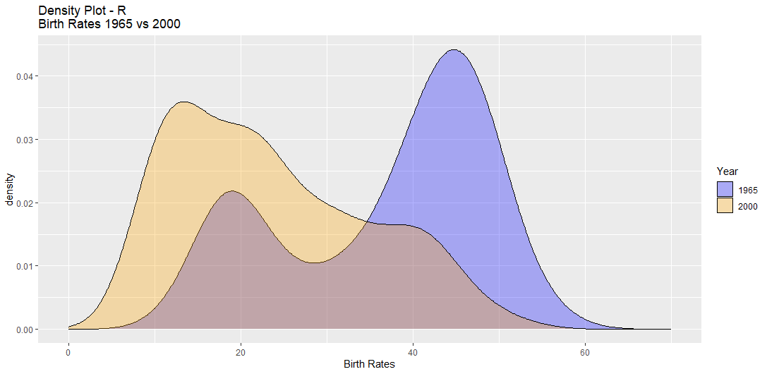
r – density plot

Slide 10
Tableau

Slide 11
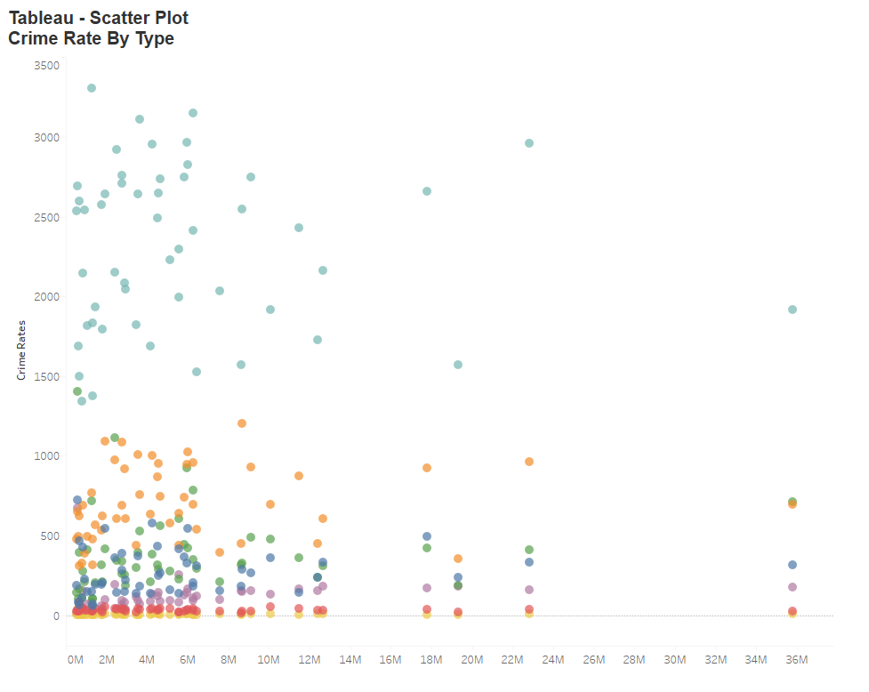
Tableau – scatter plot

Slide 12
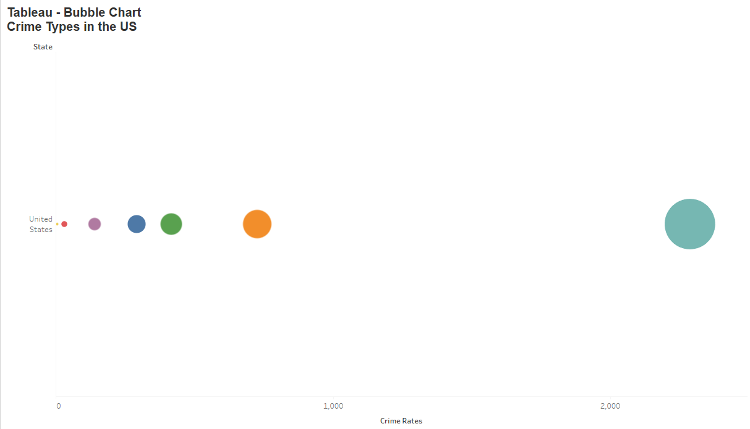
Tableau – bubble chart

Slide 13
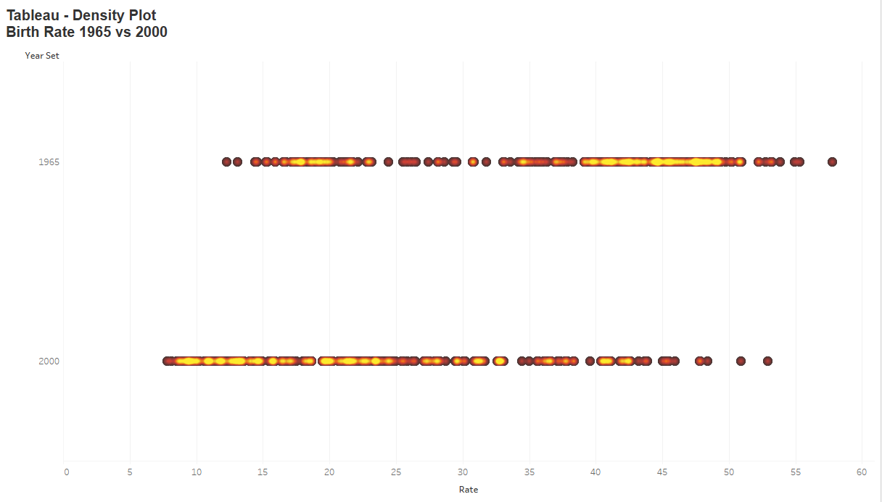
Tableau – density plot

